Slide 1


Green Pace
Security Policy Presentation
Developer: Paul Kenaga
Notes:
Good morning and welcome to the Security Policy Presentation for Green Pace. My name is Paul Kenaga and I am a developer here with the company. This presentation serves to provide implementation guidelines for security standards and policies and to offer recommendations for maintaining security in the future.

Slide 2

OVERVIEW: DEFENSE IN DEPTH
Security Policy document
Notes:
Recently I developed a Security Policy for Green Pace using best practices and industry standards to ensure that all the company’s applications comply with the same security policies. It defines the principles that are fundamental to keep applications secure from threats and mitigate vulnerabilities. It utilizes standards to exemplify relative secure coding practices and will be used to educate, align, and hold responsible the development team and all stakeholders. The policy outlines a defense-in-depth approach that uses multiple security measures to prevent security flaws from becoming exploitable vulnerabilities and to mitigate their impact. When one line of defense is unable to prevent a security flaw from being exploited, another security measure is used to defend against it; this way, defense is layered with redundant safeguards that protect data and other valuable company resources. The security policy was needed to help Green Pace transition from its DevOps practice to a DevSecOps pipeline that integrates security throughout the Software Development Lifecycle instead of addressing it at the end of development.

Slide 3
THREATS MATRIX
Priority is the intersection of impact and urgency.
Likelihood is a measure of the possibility of a threat being carried out.
Facilitates risk mitigation.
Notes:
The threat matrix on this slide evaluates threats based on priority and likelihood. Priority is the intersection of impact and urgency. Likelihood is a measure of the possibility of a threat being carried out. This threat matrix facilitates risk mitigation by determining which threats pose the most risk and should be addressed first to prevent the most damage. The threats that populate the matrix were identified based on vulnerabilities associated with unsecure coding practices. The most impactful and urgent threats are buffer overflow, SQL injection, memory protection, integer overflow and wraparound, and expression side effects. These threats are more likely to occur than the others. Less pressing and unlikely threats are unhandled expression, memory allocation, runtime assertions, and string conversion. These threats are less likely to occur but should be addressed after mitigating those with higher priority and likelihood.

Slide 4
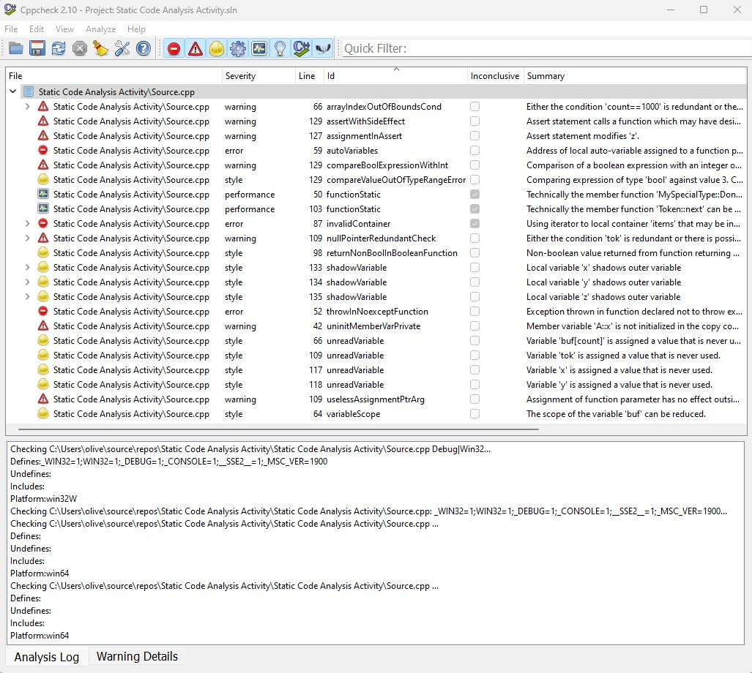
THREATS MATRIX
Priority is the intersection of impact and urgency.
Likelihood is a measure of the possibility of a threat being carried out.
Facilitates risk mitigation.
Notes:
Static analysis tools, like Cppcheck, can be used to automate detection and diagnose most of the vulnerabilities that create these threats before and during compile time.

Slide 5
10 PRINCIPLES
Notes:
The table on this slide lists the 10 security principles, in no particular order, defined in the Security Policy and maps them to coding standards that apply to each of them. It serves to show the alignment between security principles and standards. The principles are validate input data, heed compiler warnings, architect and design for security policies, keep it simple, default deny, adhere to the principle of least privilege, sanitize data sent to other systems, practice defense in depth, use effective quality assurance techniques, and adopt a secure coding standard. Most principles map to multiple secure coding standards. However, default deny and adhere to the principle of least privilege are principles that apply to Authorization standards discussed later.

Slide 6
CODING STANDARDS
Ranking was influenced by severity, likelihood, and remediation cost.
Notes:
The following table ranks the 10 secure coding standards in priority order. The ranking of standards was influenced by severity, likelihood, and remediation costs. The standards ranked at the top of the list are those that are more likely to occur and have a greater impact on security, both in damages and financially. From highest priority to lowest priority, the secure coding standards are:
Ensure that unsigned integer operations do not wrap,
Ensure that operations on signed integers do not result in overflow,
Guarantee that storage for strings has sufficient space for character data and the null terminator,
Sanitize data passed to complex subsystems,
Do not access freed memory,
Do not depend on the order of evaluation for side effects,
Detect errors when converting a string to a number,
Use static assertions to test the values of constant expressions,
Handle all exceptions,
And Declare identifiers before using them,

Slide 7
CODING STANDARDS
Noncompliant code
Ranking was influenced by severity, likelihood, and remediation cost.
Notes:
This noncompliant code is an example of when the security policy should be applied by using the ensure that operations on signed integers do not result in overflow coding standard.

Slide 8
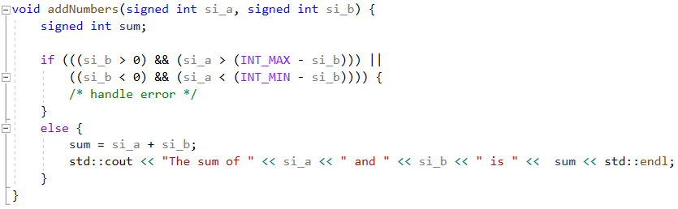
CODING STANDARDS
Noncompliant code
Compliant code
Ranking was influenced by severity, likelihood, and remediation cost.
Notes:
The compliant code is an example of the policy being applied to mitigate integer overflow vulnerabilities present in the noncompliant code by using a precondition check.

Slide 9
ENCRYPTION POLICIES
Notes:
Encryption at rest protects stored data by transforming it from plaintext to an encoded, unreadable form. It is important because even if a hacker obtains the data, it will be unusable because of its encrypted state. The policy applicable to encryption at rest is data at rest must be encrypted at all times before it is written to a database storage system or disk using the Advanced Encryption Standard (AES) algorithm, AES-256; especially sensitive data.
Encryption in flight protects data that is moving between devices or networks by encrypting it before it is sent and decrypting it after it has reached its destination. It is important because it protects data in case it is intercepted by an unauthorized entity and can inform if data has been compromised after reaching its destination. The policies applicable to encryption in flight are: Authentication and authorization must be performed to ensure that a user is who they say they are and that they have permission to access and view the data they request AND after authentication and authorization have been performed, Transport Layer Security (TLS) should be used to encrypt data before it is sent over the internet and to verify that data has not been tampered with upon its arrival.
Encryption in use protects data while it is accessed or consumed to run analytics or computations. It is important because data in use is the most vulnerable compared to at rest and in flight. The policy applicable to encryption in use is Homomorphic encryption should be used whenever mathematical computations need to be performed on data and decrypted access is not necessary to complete a task. Homomorphic encryption allows basic operations to be performed on encrypted data without first having to decrypt it.

Slide 10
TRIPLE-A POLICIES
Notes:
Authentication is a form of access control that verifies that supplied user credentials match stored user credentials to prove that a user is who they claim they are and prevent unwanted access to a system. It allows users to gain access to a system only after they have been authenticated. Authentication policies that must be adopted are User login credentials must be established for applicable users, stored in an encrypted state, conform to a secure standard, and be updated every quarter and User logins must be implemented and a user must be authenticated before they gain access to any system or resource. Following a secure standard means that a password consists of 8 or more characters and include an upper case letter, lower case letter, number, and special symbol. MFA should also be implemented as an extra layer of authentication and to follow a defense in depth approach.
Authorization is another form of access control that determines what resources an authenticated user has access to. It helps to ensure that users have permission to access resources and can be combined with the principle of least privilege to provide an extra layer of security. Authorization policies that must be adopted are Levels of access and permissions must be established upon user account creation and follow the principle of least privilege AND deny by default must be the adopted protocol for all users that do not have explicit permission to perform an action.
Accounting is the process of monitoring usage information between a user and a system. It involves measuring resources consumed, logging session statistics and user information, and tracking data sent and received. Accounting policies that must be adopted are Accounting must be implemented at all times and the data collected from it must only be accessible to those with authorization AND changes to the database and files accessed by users must be logged for authorization control, resource utilization evaluations, and audits. It is important that accounting is implemented at all times and the data collected from it is only accessible to those with authorization.

Slide 11
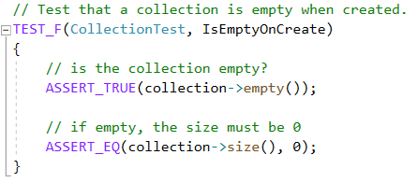
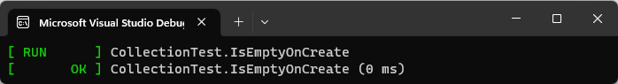
Is a vector empty when first created?
Notes:
These next few slides are examples of how to apply the unit testing framework to check the correctness and performance of code. It allows bugs to fixed early development process which is more time and cost efficient than fixing bugs at a later stage.
This is a positive unit test that checks that a vector is empty when it is first created. Positive unit tests are designed to check that code does what it is supposed to. This test asserts that the vector size is equal to 0 when it is created.

Slide 12
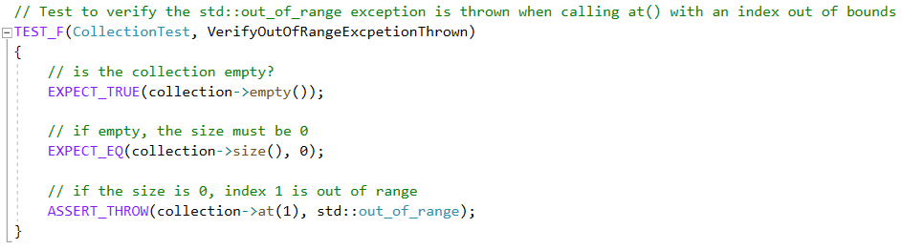
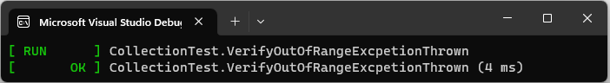
Is index 1 out of range for an empty vector?
Notes:
This is a negative unit that checks that an out of range index cannot be referenced Negative unit tests designed to check that code does not do the things it should not do.
This test asserts that an exception will be thrown when there is attempt to access an index out or range.

Slide 13
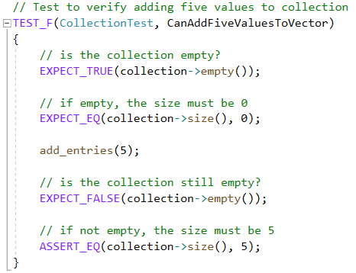
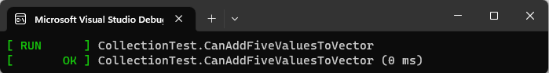
Can n values be added to a vector?
Notes:
This is another positive unit test that checks that values can be added to a vector. It asserts that adding five values to a previously empty vector changes its size to five.

Slide 14
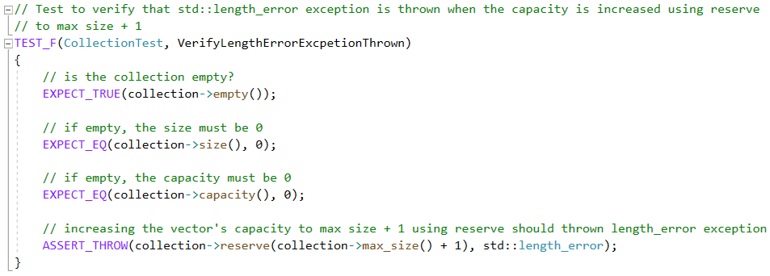
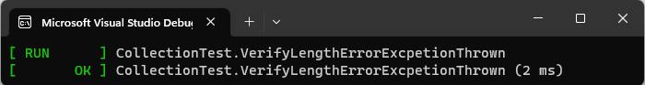
Can the capacity of a vector exceed implementation defined length limits?
Notes:
This is another negative unit test that checks that the capacity of a vector cannot exceed implementation defined length limits. It asserts that a length error exception will be thrown when an attempt is made on a vector to reserve more capacity than the limit of its max size.

Slide 15
Unit Tests
Notes:
These unit tests are only examples, but they can be modified to verify correct system behavior for valid and invalid input data. Tests can be used to assert that exceptions are thrown when invalid data is introduced or that operations accurately perform the way they were designed to when valid data is entered.

Slide 16

AUTOMATION SUMMARY
Notes:
The shift from the well-established DevOps process and infrastructure to DevSecOps will integrate security earlier in the software development life cycle (SDLC) and utilize automation to facilitate enforcement of and compliance to the standards defined in this policy. It also helps quality assurance and streamline product development because vulnerabilities can be identified and mitigated earlier in development. Security should be integrated into all stages of the SDLC.

Slide 17
Assess and Plan / Design
Assess Threat Landscape
Threat Modeling
Identify strategies to mitigate known and presumed vulnerabilities
Design test cases
Notes:
In the early, pre-production stages of development the threat landscape should be assessed followed by threat modeling. This facilitate identifying strategies to mitigate known and presumed vulnerabilities. Then test cases should be designed to address potential vulnerabilities and ensure that a system can properly handle errors and attacks.

Slide 18

Build / Verify and Test
IDE Security Plug-Ins
Static Application Security Testing
Compiler
Cppcheck
Polyspace Bug Finder
Unit testing
Notes:
As we transition deeper into development and begin to build our code it is important to check that IDE security Plug-ins are installed so that the IDE compiler can be used to automate static application security testing, also known as static analysis. Cppcheck and Polyspace Bug Finder are other tools that can be used to automate code testing and check for vulnerabilities without running code. Then test cases designed in the previous stage can be implemented to check that code functions as it is supposed to. Unit testing is great framework that can be automated to validate code functionality prior to deployment.

Slide 19
Transition and Health Check / Monitor and Detect
Dynamic Application Security Testing
Integration Testing
Penetration Testing
Parasoft C/C++test
Intruder
Interactive Application Security Testing
Logging
Event Alerts
Security Checks
Security Monitoring Loops
Notes:
Once the code has been developed, Dynamic Application Security Testing can be automated to check that there no vulnerabilities in the code while in a running state, integration testing can be automated to check that there are no vulnerabilities when code is integrated with other code, and penetration testing can be automated to check that code can with stand simulated attacks. This facilitates the transition from pre-production to production. Parasoft C/C++test and Intruder are example tools that can automate testing at this stage.
Once code is deployed into a live environment, Interactive application security testing can be automated to test applications for vulnerabilities while they are being used. Additionally, logging, event alerts, security checks, and security monitoring loops can be automated to detect and inform of attacks and leaks as well as monitor questionable behavior.

Slide 20
Respond / Maintain and Stabilize
Attack Response
Roll Back
Jira
Notes:
When a threat is detected, an attack response must be executed. In some cases, it may be beneficial to roll back a database or code to a previous “clean” or functioning state. JIRA is a helpful tool that can be used to track and prioritize bugs. It can facilitate mitigation efforts during the next iteration of development.

Slide 21

RISKS AND BENEFITS
Act Now = Proactive Approach
Problem
Some threats not immediately known
Solution
Consider the motive for the attack
Benefits
Speedier Recovery
Data Integrity
Compliance
Peace of Mind
Wait = Reactive Approach
Problem
Attacks will occur unnoticed
Risks
Data Loss/Corruption
Steeper Remediation Costs
Reputational Damage
Fines
Solution
Be Proactive and Act Now
Notes:
Acting now is a proactive approach. However, the problem with a proactive approach is that some threats are not always immediately known. The solution is to adopt the mindset of the attacker so that motive for the attack can be considered. The benefits of acting now are speedier recovery times, data integrity, regulatory compliance, and a peace of mind that code and applications are secure.
Waiting is a reactive approach that can essentially allow attacks to occur unnoticed or at least occur without an immediate response. The risks associated with this problem are data loss and corruption, higher costs to remediate problems, irreversible damage to the company’s reputation, and regulatory fines. The solution is to adopt a proactive mindset and to act now rather than wait for threats to occur.

Slide 22

RECOMMENDATIONS
Physical Protection
Data Back up
Endpoint Security
Cloud tools
AWS
Social Engineering Attacks
Twilio Phishing Attack
Notes:
Current gaps in the security policy that still need to be addressed are physical security of company resources like the database server, data backup protocols, endpoint security, security for cloud tools such as any from the Amazon Web Services ecosystem, and, lastly, social engineering attack protocols. Social engineering attacks such as the Twilio phishing attack that occurred in mid-July 2022 are especially threatening because they trick people into security mistakes that can compromise data and operations. All company employees and third-party vendors with any type of system access are vulnerable to these attacks. The Twilio phishing attack tricked some of their employees into providing their system credentials which allowed hackers to gain access to customer data.

Slide 23
CONCLUSIONS
Follow the principles outlined in the Security Policy document
Adopt the secure coding standards outlined in the Security Policy document
Layer defense strategies to mitigate threats
Always encrypt data whenever possible
Triple-A Framework
“Keep it simple” with automation
Next Steps
Physically secure servers
Phishing prevention training
Secure cloud applications
Endpoint Detection and Response
Backup database every 24 hours
Contact the office of the Chief Information Security Officer with any questions.
Notes:
The security steps that can be taken now to protect code and applications from threats are:
Follow the principles outlined in the Security Policy document
Adopt the secure coding standards outlined in the Security Policy document
Layer defense strategies to mitigate threats
Always encrypt data whenever possible
Adopt the Triple-A Framework
And “Keep it simple” with automation
Next steps that should be adopted to prevent future problems are to physically secure servers and other significant company resources. This can be as simple as having CCTV Video surveillance.
Next, Periodic company-wide training to educate all employees and third-party vendors on the signs and dangers of social engineering attacks like phishing scams.
Security protocols for cloud applications such as AWS should also be implemented.
Endpoint Detection and Response should be used to detect threats across any device that accesses company systems such as mobile phones and laptops.
And, finally, adopt a backup strategy such as backing up databases every 24 hours to protect and restore data when disasters occur. Thank you for your time, this concludes my presentation. Please direct any questions or concerns to the office of the Chief Information Security Officer.

Slide 24
REFERENCES
Conklin, L. (n.d.). Threat Modeling Process. OWASP Foundation. https://owasp.org/www-community/Threat_Modeling_Process
Froehlich, A. (2022). How to secure data at rest, in use and in motion. TechTarget. https://www.techtarget.com/searchsecurity/feature/Best-practices-to-secure-data-at-rest-in-use-and-in-motion
Gillis, A. S. (2022). homomorphic encryption. TechTarget. https://www.techtarget.com/searchsecurity/definition/homomorphic-encryption
Hurley, J. (2019, September 1). File:Cybersecurity Visuals Challenge 2019 - John Hurley.png. Wikimedia Commons. https://commons.wikimedia.org/wiki/File:Cybersecurity_Visuals_Challenge_2019_-_John_Hurley.png
Incident Report: Employee and Customer Account Compromise. (2022, October 27). Twilio Blog. https://www.twilio.com/blog/august-2022-social-engineering-attack
Interactive Application Security Testing (IAST). (2021, April 20). Snyk. https://snyk.io/learn/application-security/iast-interactive-application-security-testing/
Magnusson, A. (2022, December 9). What is AAA Security? Authentication, Authorization, and Accounting. strongdm. https://www.strongdm.com/blog/aaa-security
Mathenge, J. (2020, January 1). Impact, Urgency & Priority: Understanding the Matrix. BMC Blogs. https://www.bmc.com/blogs/impact-urgency-priority/

